Slide 1
Chapter 9: data warehousing
Modern Database Management
12th Edition
Jeff Hoffer, Ramesh Venkataraman,
Heikki Topi

Slide 2
Objectives
Define terms
Give reasons for information gap between information needs and availability
List reasons for need of data warehousing
Describe three levels of data warehouse architectures
Describe two components of star schema
Estimate fact table size
Design a data mart
Develop requirements for a data mart
Understand future data warehousing trends

Slide 3
Final project registration
Link for group registration:
https://docs.google.com/spreadsheets/d/15VtCIA_GjxXpSVWFZkJrVla4yc6lMTIWHBURvBcCvBA/edit?usp=sharing

Slide 4
Definitions
Data Warehouse
A subject-oriented, integrated, time-variant, non-updatable collection of data used in support of management decision-making processes. Key terms are:
Subject-oriented: Organized on key objects such as customers, patients, students, products
Integrated: consistent naming conventions, formats, encoding structures; from multiple data sources
Time-variant: Contain time dimensions to study trends and changes
Non-updatable: read-only, periodically refreshed from operational systems, not from end-users
Data Mart
A data warehouse that is limited in scope
Notes:
The purpose of a data warehouse is to assist with managerial decision-making. This is different from the purpose of a transaction-oriented database, which is to support and record the day-to-day operations and transactions of a business. The data produced in transaction-oriented databases forms much of the input for a data warehouse.
Data warehousing is the process whereby organizations create and maintain data warehouses and extract meaning from and help inform decision making through the use of data in the data warehouses. Successful data warehousing requires following proven data warehousing practices, sound project management, strong organizational commitment, as well as making the right technology decisions.

Slide 5
DATA WAREHOUSING
Is the process where organizations create and maintain data warehouse
Extract meaning and form decision making from informational assets through these warehouses.

Slide 6
Need for Data Warehousing
Integrated, company-wide view of high-quality information (from different databases)
Separation of operational and informational systems and data (for improved performance)
Notes:
Operational data and systems are fragmented and inconsistent, often in separate, incompatible silos. They may be distributed in several hardware and software platforms, with some running Oracle in a UNIX operating system, and another involving ERP products like SAP. But, for decision-making purposes, it is often necessary to provide a single, corporate view of that information.
Queries on data warehouses are often very complex, because of needing to deal with managerial needs. This requires significant computing resources. Operational systems (or “systems of record”) should not need to compete for resources with data warehouses, so these should be separated. Also, as we’ll see, the data warehouse structure is different from an operational database, with much less need for normalization.

Slide 7
CONTENT OF A DATA WAREHOUSE
Your data warehouse will store these types of data:
Historical data: Data is recorded throughout history
Derived data: Data is filtered and transformed to information
Metadata: Data that describe data and schema objects

Slide 8
Issues with Company-Wide View (FIG 9-1)
Inconsistent key structures: 1st and 2nd table contains number, the last contains string.
Synonyms: StudentID and number is the same
Free-form vs. structured fields:
In student health: StudentName consists of first/last name whereas in Student Data: name is broken into parts
Inconsistent data values: Conflicts in Mr Smith phone numbers (using 1 or 2 number)
Missing data: Insurance value is missing.

Slide 9
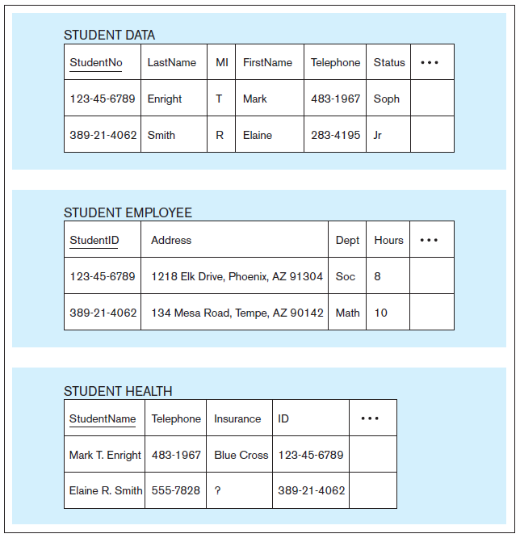
Figure 9-1 Examples of heterogeneous data
Notes:
A university may have several departments and units. Each may have its own databases, with different versions of student information. Although we used normalization to reduce duplication within a database, in reality organizations may distribute data (for example about students) among different databases, and this could even involve duplication.
Collecting all that data from the data sources, ensuring it is consistent and valid, and transforming it to a common framework are important tasks in the data warehousing process.

Slide 10
Organizational Trends Motivating Data Warehouses
No single system of records
Split into several databases.
Multiple systems not synchronized:
All data from separate system must be synced into additional database.
Organizational need to analyze activities in a balanced way
Result must be consistent, data wh is necessary
Notes:
It is ironic that organizations spend so much time and effort to normalize a database, and yet often keep many different databases for different business purposes. This leads to the possibility of data duplication, which normalization was supposed to remove.

Slide 11
Cont (2)
Customer relationship management
To view overall picture of activity with customer across all touch points
Supplier relationship management
To view overall picture of activity with supplier across all touch points, from billing, meeting, quality control, pricing and support

Slide 12
Separating Operational and Informational Systems
Operational system – a system that is used to run a business in real time, based on current data; also called a system of record
For example: Reservation system, sales order processing systems, …
Notes:
The data warehouse is an informational system. Operational databases are often called “online transaction processing (OLTP) databases, whereas data warehouses are associated with “online analytical processing (OLAP)” systems.

Slide 13
CONT
Informational system – a system designed to support decision making based on historical point-in-time and prediction data for complex queries or data-mining applications
For example: sale trends analysis, human resource planning

Slide 14
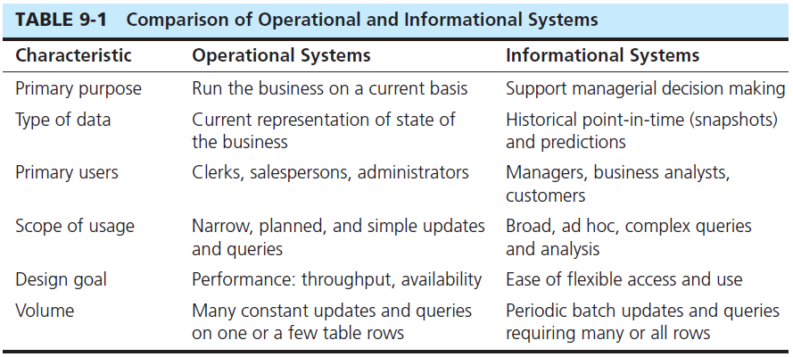
Notes:
As you can see there are many differences between operational and informational systems.

Slide 15
THE NEED TO SEPARATE BETWEEN INFOR. And OP. system
A data warehouse centralizes data that are scattered throughout disparate operational systems and makes them readily available for decision support applications.
A properly designed data warehouse adds value to data by improving their quality and consistency.
A separate data warehouse eliminates much of the contention for resources that results when informational applications are confounded with operational processing.

Slide 16
Data Warehouse Architectures
Independent Data Mart
Dependent Data Mart and Operational Data Store
Logical Data Mart and Real-Time Data Warehouse
Three-Layer architecture
All involve some form of extract, transform and load (ETL)
Notes:
There are a variety of data warehouse architectures. Some emphasize a central enterprise warehouse. Others involves smaller department-wide data marts. Some combine these features. Yet others are “virtual” data warehouses were data is obtained in real time from the data sources and the necessary transformations are done ad hoc.
The concept of extract/transform/load (ETL) will be discussed in detail in chapter 10.

Slide 17
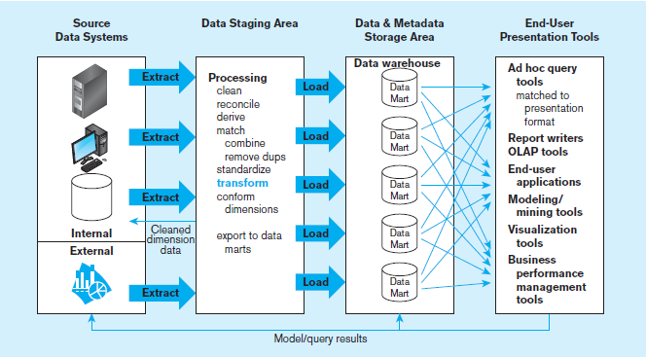
Figure 9-2 Independent data mart data warehousing architecture
Data marts:
Mini-warehouses, limited in scope
L
T
E
Separate ETL for each independent data mart
Data access complexity due to multiple data marts
Notes:
The independent data mart architecture was espoused by Ralph Kimball, one of the principal pioneers of data warehousing.
Building this architecture involves these four basic steps:
1. Data are extracted from the various internal and external source system files and databases. In a large organization, there may be dozens or even hundreds of such files and databases.
2. The data from the various source systems are transformed and integrated before being loaded into the data marts. Transactions may be sent to the source systems to correct errors discovered in data staging. The data warehouse is considered to be the collection of data marts.
3. The data warehouse is a set of physically distinct databases organized for decision support. It contains both detailed and summary data.
4. Users access the data warehouse by means of a variety of query languages and analytical tools. Results (e.g., predictions, forecasts) may be fed back to data warehouse and operational databases.
Each of these data marts are limited in scope, and there is not centralized data warehouse. Thus, they do not give the overall picture of the entire organization. However, they are typically easier to build than a full-fledged enterprise-wide data warehouse,

Slide 18
Limitations of independent Data Marts
Separate ETL process for each data mart ➔ redundant data and processing
Inconsistency between data marts
Difficult to drill down for related facts between data marts, analysis is limited
Excessive scaling costs are more applications are built since add new data mart is costly, repeat ETL process.
High cost for obtaining consistency between marts
Notes:
Because of these problems, there is a debate about the usefulness of independent data marts. Although Kimball espouses this approach, others including Bill Inmon find fault with it.

Slide 19
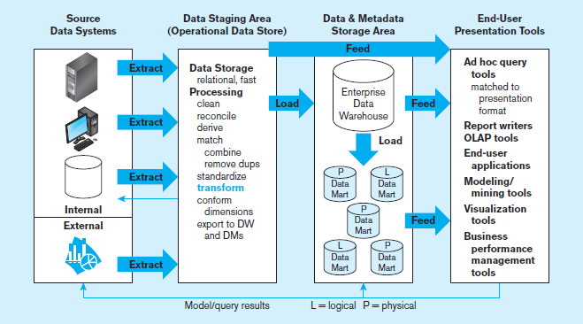
Figure 9-3 Dependent data mart with operational data store: a three-level architecture
ODS provides option for obtaining current data
L
T
E
Simpler data access
Single ETL for
enterprise data warehouse (EDW)
Dependent data marts loaded from EDW
Notes:
In the case of dependent data marts, there is a centralized enterprise-wide data warehouse, and the data marts are loaded from this enterprise DW. The EDW is a centralized, integrated data warehouse, serving as the control point and single source of all data made available to end users for decision support applications.
The dependent data mart approach is often called a “hub-and-scope” architecture. Another term often used is “corporate information factory”. Bill Inmon, another famous DW pioneer is an advocate for this more centralized approach.
Note the operational data store (ODS). This is an integrated, subject-oriented, continuously updateable, current-valued (with recent history), enterprise-wide, detailed database designed to serve operational users as they do decision support processing.

Slide 20
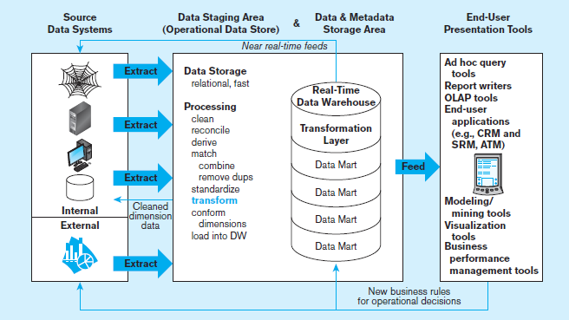
Figure 9-4 Logical data mart and real time warehouse architecture
ODS and data warehouse are one and the same
L
T
E
Near real-time ETL for
Data Warehouse
Data marts are NOT separate databases, but logical views of the data warehouse
➔ Easier to create new data marts
Notes:
A logical data mart is not a physically separated database. Rather, it is created by a relational view of a data warehouse. Remember the concept of a “view”, which was discussed in chapter 6.
The notion of a real-time data warehouse means that the source data systems, decision support services, and the data warehouse exchange data and business rules at a near-real-time pace. This helps to give a more current and comprehensive picture of the organization.
However, the logical data mart and real-time data warehouse architecture is practical for only moderate-sized data warehouses or when using high-performance data warehousing technology, such as the Teradata system. The difficulty with this approach stems from the attempt to keep the DW current, which requires more-or-less continuous processing.
This has a couple advantages. First, new data marts can be created quickly because no physical database or database technology needs to be created or acquired and no loading routines need to be written. Second, the data marts are always up to date because data in a view are created when the view is referenced; views can be materialized if a user has a series of queries and analysis that need to work off the same instantiation of the data mart.

Slide 21
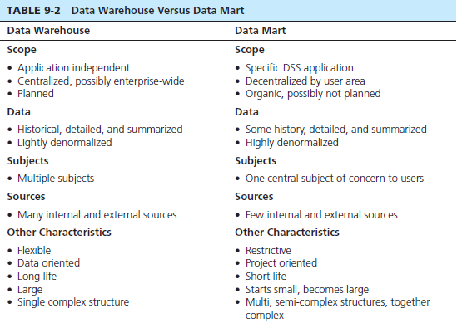
Notes:
This table illustrates the differences between data warehouses and d
As you can see, data marts and data warehouses play different roles in a data warehousing environment. Scalable technology is critical here.
As data marts are added, a data warehouse can be built in phases; the easiest way for this to happen is to follow the logical data mart and real-time data warehouse architecture.

Slide 22
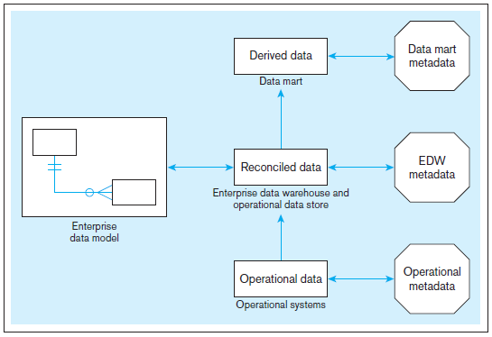
Figure 9-5 Three-layer data architecture for a data warehouse
Notes:
The three-layer data architecture for data warehousing involves operational, reconciled, and derived data.
Operational data are stored in the various operational systems of record throughout the organization (and sometimes in external systems).
Reconciled data are the type of data stored in the enterprise data warehouse and an operational data store. Reconciled data are detailed, current data intended to be the single, authoritative source for all decision support applications.
Derived data are the type of data stored in each of the data marts. Derived data are data that have been selected, formatted, and aggregated for end-user decision support applications.
Each of these involve metadata geared to the particular need. For operational systems, the metadata is geared to the day-to-day transactional operations of the business. Sometimes, this may not be of good quality, especially for decision support purposes. EDW metadata includes rules for extracting, transforming, and loading operational data into reconciled data. And data mart metadata describe the derived data layer and the rules for transforming reconciled data to derived data.

Slide 23
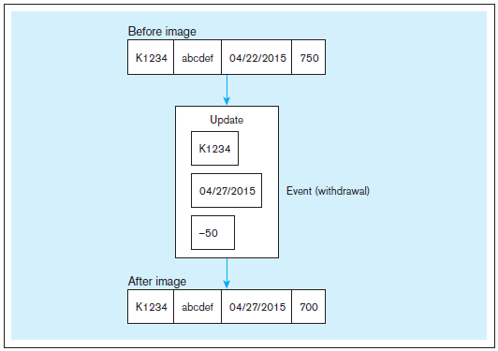
Data Characteristics Status vs. Event Data
Figure 9-6 Example of DBMS log entry
Status
Event = a database action (create/ update/ delete) that results from a transaction
Status
Notes:
As we will see in the next few slides, the characteristics of data for a data warehouse are different from those of data for operational databases.
For example, here we see the distinction between status and event data. Status data would typically be stored in an operational database, as a result of a transaction. The transaction will cause changes to this data over time, as we see in this example. But the fact of the transaction itself is not stored in the database. It is, however recorded in the database log. Sometimes this is important information for a data warehouse. For example we may want to know how many transactions are taking place, or when they take place. Consequently log data is often part of what gets loaded into a data warehouse, in addition to the data actually stored in the operational database.

Slide 24
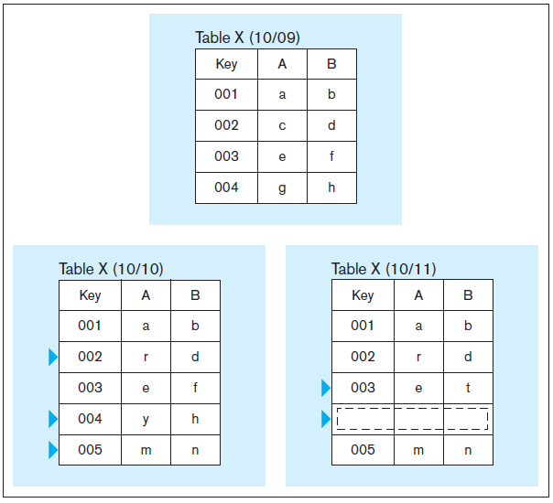
Data Characteristics
Transient(Tạm thời) vs. Periodic (ĐỊnh KÌ) Data
Figure 9-7 Transient operational data
With transient data, changes to existing records are written over previous records, thus destroying the previous data content.
Notes:
Another important distinction is between transient and periodic data. Operational data is typically transient. When a record changes, the old data is not maintained, but is replaced with the new data. For example, in this case, when row 2 Is changed, its old data is lost. When row 4 is deleted, its old data is also lost.
However, for a data warehouse, which is “time-variant”, maintaining historical data is important.

Slide 25
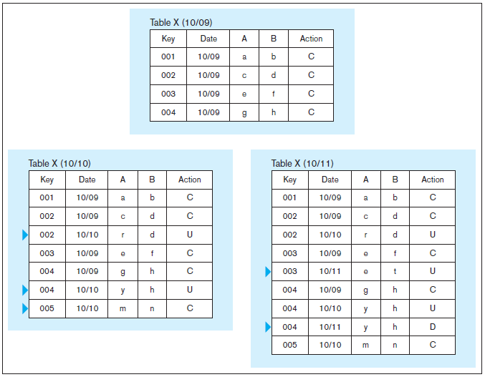
Data Characteristics
Transient vs. Periodic Data
Figure 9-8 Periodic warehouse data
Periodic data are never physically altered or deleted once they have been added to the store.
Notes:
This slide shows periodic data. Note that in this case, the old data is not removed. Rather, it is kept in the data warehouse to maintain a historical record. Here, we’ve added two columns. One shows the date at which an action was done, and the second is the action itself. The actions could be create, update, or delete. Thus, the data warehouse does not just include data, it also includes a history of transactions that created, modified, or removed the data.

Slide 26
Other Data Warehouse Changes NEED TO BE ACCOMMODATED
New descriptive attributes
New business activity attributes
New classes of descriptive attributes = new table
Descriptive attributes become more refined
Descriptive data are related to one another
New source of data

Slide 27
Derived Data
Objectives
Ease of use for decision support applications
Fast response to predefined user queries
Customized data for particular target audiences
Ad-hoc query support
Data mining capabilities
Characteristics
Detailed (mostly periodic) data
Aggregate (for summary)
Distributed (to departmental servers)
Most common data model = dimensional model
(usually implemented as a star schema)
Notes:
Derived data as data that have been selected, formatted, and aggregated for end-user decision support applications. In other words, derived data are information instead of raw data. Its source is reconciled data, or data that has been integrated and transformed from the original data sources (via the ODS).

Slide 28
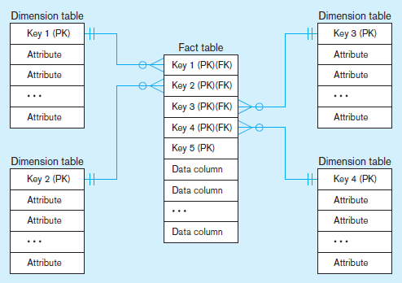
Figure 9-9 Components of a star schema
Fact tables contain factual or quantitative data
1:N relationship between dimension tables and fact tables
Dimension tables are denormalized to maximize performance
Dimension tables contain descriptions about the subjects of the business
Excellent for ad-hoc queries, but bad for online transaction processing
Notes:
A star schema is a simple database design in which dimensional data are separated from fact or event data. Another name for star schema is “dimensional model”.
The star schema is composed of fact and dimension tables. Note that the fact table is in essence an associative entity that joins various dimension tables.
The dimension tables are usually the source of attributes used to qualify, categorize, or summarize facts in queries, reports, or graphs; thus, dimension data are usually textual and discrete.
Fact tables contain factual or quantitative data (measurements that are numerical, continuously valued, and additive) about a business, such as units sold, orders booked, and so on.

Slide 29
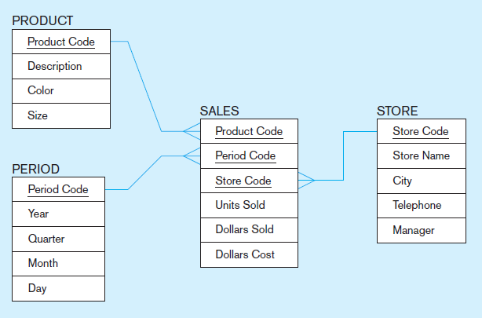
Figure 9-10 Star schema example (data recored daily)
Fact table provides statistics for sales broken down by product, period and store dimensions
Notes:
Here we have a fact table surrounded by three dimension tables. Each fact shows sales data for a particular product from a particular store during a particular time period. The data in the fact table was likely derived from operational database’s sales data. Note that this is summary data. The operational database has records of each sale, but here we are getting summary data (units sold, dollars sold, dollars cost). This is typical in data warehouses, and has to do with another concept we will soon discuss, the concept of “granularity”.

Slide 30
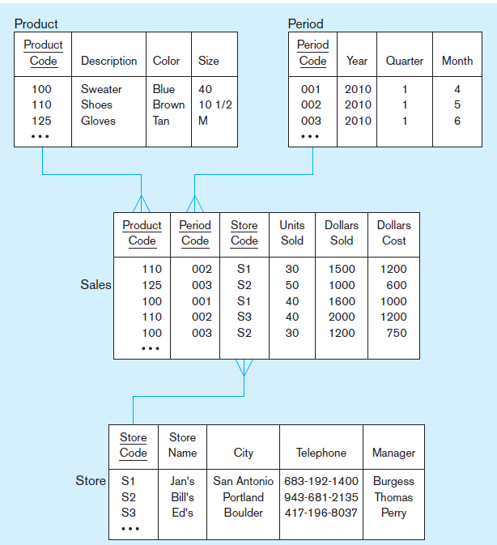
Figure 9-11 Star schema with sample data
Notes:
This is the same star schema showing the data. Notice that the fact table has numeric data and foreign keys. The dimension tables have primary keys and discrete data.
Question: What can you say about unit sales for store S2?
Answer: 50 units of product 125 (gloves) and 30 units of product 100 (sweaters) were sold in June 2010.
Question: Which store(s) sold shoes and when?
Answer: S1 (Jan’s) in May 2010, and S3 (Ed’s) in June 2010.
Question: Which time period has the most total dollars sold?
Answer: Time period 002 (May 2010) has the most, with a total of $3500.

Slide 31
Surrogate (REPRESENTATIVE) Keys
Dimension table keys should be surrogate (non-intelligent and non-business related), because:
Business keys may change over time
Helps keep track of nonkey attribute values for a given production key
Surrogate keys are simpler and shorter
Surrogate keys can be same length and format for all key
Notes:
The primary key of the fact table is typically a composite of all its foreign keys.

Slide 32
Grain of the Fact Table
Granularity of Fact Table: level of detail in the fact table
Transactional grain–finest level
Aggregated grain–more summarized
Finer grains ➔ better market basket analysis capability
Finer grain ➔ more dimension tables, more rows in fact table
Notes:
The term “Grain” or “Granularity” refers to the level of detail in a fact table, determined by the intersection of all the components of the primary key, including all foreign keys and any other primary key elements.
Kimball and others recommend using the smallest grain possible, given the limitations of the data mart technology. Even when data mart user information requirements imply a certain level of aggregated grain, often after some use, users ask more detailed questions (drill down) as a way to explain why certain aggregated patterns exist. You cannot “drill down” below the grain of the fact tables. But, fine grain means higher volume of data.

Slide 33
Duration of the Database
Amount of history to be kept on database
Natural duration–13 months or 5 quarters
Financial institutions may need longer duration
Older data is more difficult to source and cleanse

Slide 34
Size of Fact Table
Depends on the number of dimensions and the grain of the fact table
Number of rows = product of number of possible values for each dimension associated with the fact table
Notes:
From here, we could determine the total size in bytes for the table. For example, if the fact table has 6 fields each of four bytes, this would total 2.88 gigabytes of data. (120,000,000 X 6 X 4).

Slide 35

SIZE OF FACT TABLE
Example: Assume the following for Figure 9-11:
Total rows calculated as follows (assuming only half the products record sales for a given month):
If fact table contains 6 fields, each of 4 bytes
=> 120.000 k rows * 6 * 4 = 2.88GB of data.

Slide 36
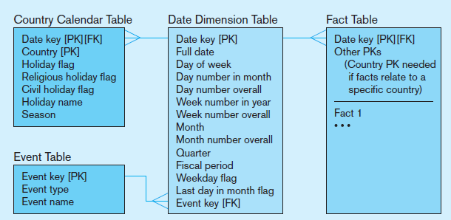
Figure 9-12 Modeling dates and time
Fact tables contain time-period data
➔ Date dimensions are important
Notes:
Because data warehouses and data marts record facts about dimensions over time, date and time is always a dimension table, and a date surrogate key is always one of the components of the primary key of any fact table. This is one of the reasons we consider data warehouses to be time-variant.
Note that the Date dimension table includes many non-key attributes, as you see here. The non-key attributes include all of the characteristics of dates that users use to categorize, summarize, and group facts.
Question: In this model, what can you say about how many events could be associated with a particular date?
Answer: Only one! That may be a weakness in the model.

Slide 37
Variations of the Star Schema
Multiple Facts Tables
Can improve performance
Often used to store facts for different combinations of dimensions
Conformed dimensions
Factless Facts Tables
No nonkey data, but foreign keys for associated dimensions
Used for:
Tracking events
Inventory coverage
Notes:
There are many nuances of star schemas as shown here.
To improve performance you may want to have more than one fact table in a given star schema. For example, suppose that various users require different levels of aggregation (grain). Performance can be improved by defining a different fact table for each level of aggregation. The obvious trade-off is that storage requirements may increase dramatically with each new fact table.
More commonly, multiple fact tables are needed to store facts for different combinations of dimensions, possibly for different user groups. The next slide shows an example.

Slide 38
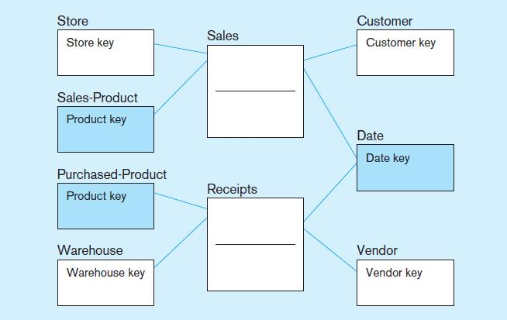
Figure 9-13 Conformed dimensions
Two fact tables ➔ two (connected) star schemas.
Conformed dimension Associated with multiple fact tables, here, date & product key
Notes:
Here we see a typical situation of multiple fact tables with two related star schemas. In this example, there are two fact tables, one at the center of each star:
Sales—facts about the sale of a product to a customer in a store on a date
Receipts—facts about the receipt of a product from a vendor to a warehouse on a date
These two star schemas are connected via a common dimension (Date). The term for this is a “conformed dimension”. Conformed dimensions are dimension tables associated with two or more fact tables for which the dimension
tables have the same business meaning and primary key with each fact table.

Slide 39
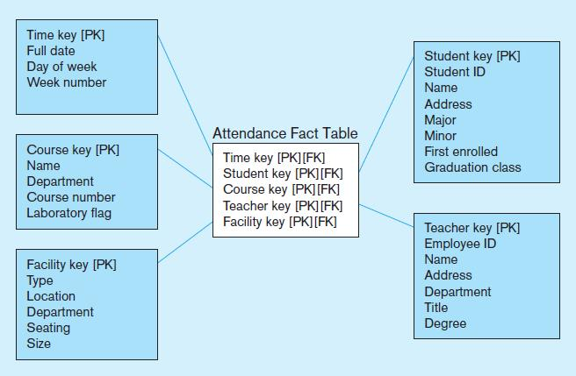
Figure 9-14a Factless fact table showing occurrence of an event
No data in fact table, just keys associating dimension records
Fact table forms an n-ary relationship between dimensions
Notes:
Why would you want a “factless fact table”? Generally for the same reason you would want associative entities; that is to maintain relationships between dimension tables. Here we see the use of an Attendance fact table containing nothing but foreign keys. This is useful for tracking events, specifically tracking which students attend which courses at which time in which facilities with which instructors.

Slide 40
Normalizing Dimension Tables
Multivalued Dimensions
Facts qualified by a set of values for the same business subject
Normalization involves creating a table for an associative entity between dimensions
Hierarchies
Sometimes a dimension forms a natural, fixed depth hierarchy
Design options
Include all information for each level in a single denormalized table
Normalize the dimension into a nested set of 1:M table relationships
Notes:
Although fact tables are normalized, often dimension tables may not be. This enables dimension tables to be only one join away from the fact table, improving query performance. Of course, non-normalized data involves data duplication.
Question: Why is this not a problem?
Answer: because the data warehouse is not volatile. Data doesn’t change like a transaction processing database.

Slide 41
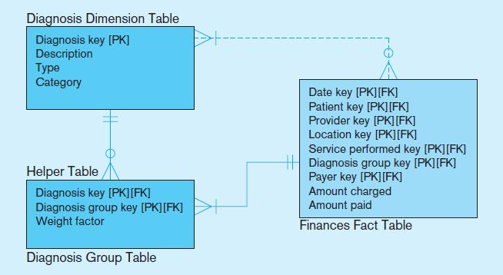
Figure 9-15 Multivalued dimension
Helper table is an associative entity that implements a M:N relationship between dimension and fact.
Notes:
Although fact tables are usually on the many side of a 1:N relationship with their associated dimensions, there are circumstances where facts may need to have M:N relationships. In a data warehouse, this is facilitated through the use of a “helper” table, which is an associative entity between the fact and the dimension.

Slide 42
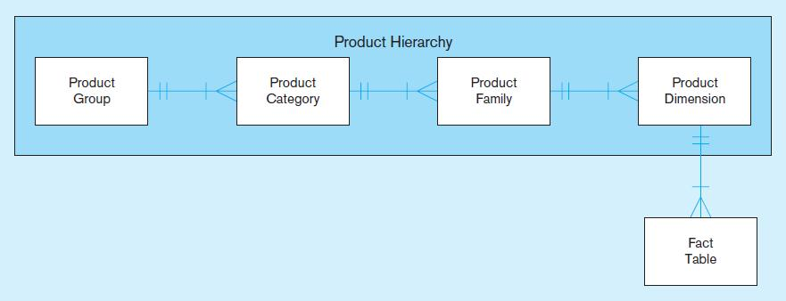
Figure 9-16 Fixed product hierarchy
Dimension hierarchies help to provide levels of aggregation for users wanting summary information in a data warehouse.
Dimension tables are normalized into several related tables
Notes:
In this figure we see the hierarchy implemented via normalized dimension tables. This prevents duplication of product groups, categories and families. But a query for a fact that required the product group would need to involve five tables in the join.
But, it could also have been implemented as a single Product dimension table, with all the other data (group, category, family) included. In this case there would be data duplication, but the queries would be simplified, requiring only two tables in the join.
Note: in this figure, we do not have a star schema. A star involves only fact tables surrounded by immediately connected dimensions. Here, we have a cascade of dimensions leading to the fact. This is commonly called a “snowflake” schema. A snowflake schema is An expanded version of a star schema in which dimension tables are normalized into several related tables.
Another common example of a dimension hierarchy can be seen in the Date dimension (found in figure 9-12). Within the same table, you have year, composed of quarters, which are further composed of months, then weeks, then finally days. Here, the entire hierarchy is represented in a single dimension table, not in separate normalized tables.

Slide 43
Slowly Changing Dimensions (SCD)
How to maintain knowledge of the past
Kimball’s approaches:
Type 1: just replace old data with new (lose historical data)
Type 2: for each changing attribute, create a current value field and several old-valued fields (multivalued)
Type 4: create a new dimension table row each time the dimension object changes, with all dimension characteristics at the time of change. Most common approach

Slide 44


Type 1
Consider [Supplier] table
When apply Type 1
No history changes tracking

Slide 45



Type 2
Add new version column
Or add start/end date column’
Or add date with flag (Y: current version)

Slide 46
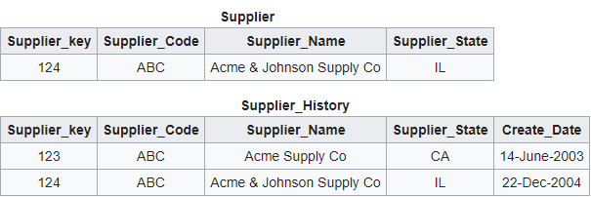
TYPE 4:
Add new history log table

Slide 47
10 Essential Rules for Dimensional Modeling
Use atomic facts
Create single-process fact tables
Include a date dimension for each fact table
Enforce consistent grain
Disallow null keys in fact tables
Honor hierarchies
Decode dimension tables
Use surrogate keys
Conform dimensions
Balance requirements with actual data
Notes:
1. Use atomic facts: Eventually, users want detailed data, even if their initial requests are for
summarized facts.
2. Create single-process fact tables: Each fact table should address the important measurements
for one business process, such as taking a customer order or placing a material purchase order.
3. Include a date dimension for every fact table: A fact should be described by the
characteristics
of the associated day (or finer) date/time to which that fact is related.
4. Enforce consistent grain: Each measurement in a fact table must be atomic for the same
combination of keys (the same grain).
5. Disallow null keys in fact tables: Facts apply to the combination of key values, and helper
tables may be needed to represent some M:N relationships.
6. Honor hierarchies: Understand the hierarchies of dimensions and carefully choose to
Snowflake the hierarchy or denormalize into one dimension.
7. Decode dimension tables: Store descriptions of surrogate keys and codes used in fact tables
in associated dimension tables, which can then be used to report labels and query filters.
8. Use surrogate keys: All dimension table rows should be identified by a surrogate key, with
descriptive columns showing the associated production and source system keys.
9. Conform dimensions: Conformed dimensions should be used across multiple fact tables.
10. Balance requirements with actual data: Unfortunately, source data may not precisely
Support all business requirements, so you must balance what is technically possible with
what users want and need.

Slide 48
The Future of Data Warehousing: Integration with Big Data and Analytics
Issue of Big Data (huge volume, often unstructured)
Speed of processing
Design/purchase storage, database, and networking aspects in tandem
Use in-memory databases (RAM instead of disk)
Add analytics capabilities closer to the original data sources instead of separate data warehouses
Cost of Data Storage
Move data warehouse to the cloud
Use Columnar databases for storage optimization
Unstructured Data
NoSql “Not only SQL”
Hadoop
Notes:
Vendors making advances in these areas include Teradata, Oracle, SAP (HANA), Microsoft, IBM, and Amazon.

Slide 49


